Slide 1

UNIT – IV
Department of Computer Science

Slide 2

Functions

Slide 3
Functions
Function is a group of statement or instructions that are written with a purpose to perform certain task whenever it is required.
In C++, we can divide a large program into the basic building blocks known as function.
A function can be called multiple times to provide reusability and modularity to the C++ program.
In other words, we can say that the collection of functions creates a program.

Slide 4
Functions (Cont…)
Types of Functions
There are two types of programming functions in C++.
Library (or Built-in) Functions :
Library (or Built-in) functions are predefined functions provided by the C++ Standard Library. They are stored in header files like <iostream>, <cmath>, <cstring>, <cctype>, <ctime>. They make programming easier, faster, and more reliable since they are already tested and optimized. Common categories include:
Input/Output functions (cin, cout)
Mathematical functions (sqrt(), pow(), abs())
String functions (strlen(), strcpy(), strcmp())
Character functions (isalpha(), isdigit(), toupper())
Time functions (time(), ctime())

Slide 5
User-defined functions: are the functions which are created by the C programmer, so that he/she can use it many times. It reduces the complexity of a big program and optimizes the code.

Slide 6
Functions (Cont…)
Advantages of using Functions
Support for Modularity & Modular Programming: It is a programming paradigm that breaks down the bigger problem into the smaller sub- problems. These sub-problems are solved (programmatically) separately and their solutions are combine to solve the bigger problem.
Easier to write and understand the program.
Fault detection and isolation is easy.
Debugging and maintenance is easier.
Facilitates reusability of code.

Slide 7
Functions (Cont…)
Functional Aspects
A user defined function basically involve following three aspects:
1) Function Declaration/Prototyping
return_type function_name(parameter_list);
2) Function Definition
int add(int a, int b) {
return a + b; }
3) Function Calling
int result = add(5, 10);

Slide 8
Functions (Cont…)
Function Declaration/Prototyping
A function declaration tells a compiler following three things:
i) Name of Function: It is an identifier (user defined name) given to the function.
ii) Return Type: It is specify the datatype of the value returned by the function.
iii) Arguments/Parameter List: It specifies the number of arguments along with their data types
Syntax:
return_type function_name (Argument_List);
int sum (int x, int y); OR int sum (int, int);

Slide 9
Functions (Cont…)
Function Definition:
A function definition is used to specify the sequence of
statements that are to be written in the body of the function.
Syntax:
return_type function_name(Argument_List)
{
//Body of the Function
Return_value
}
Example:
int sum(int x, int y)
{
int z; z=x+y; return z;
}

Slide 10
Functions (Cont…)
Function Calling:
Whenever there is requirements of performing the task written in the function, the function is called during the execution of the program.
Syntax:
Function_name (Actual_Argument_List);
Example:
sum(5, 10);
Note: In declaration name of argument is not compulsory but in the definition it is compulsory.

Slide 11
Functions (Cont…)
WAP in C to Add Two Numbers using Function.
#include<stdio.h>
int sum(int, int); //Global Declaration of sum()
int sum(int a, int b)
{
int c; c=a+b; return c;
}
//Function Definition of sum()
void main()
{
int a,b,c;
printf("Enter Two Numbers \n"); scanf("%d%d",&a,&b);
c=sum(a,b); //Function Calling
printf("Sum of Two Numbers = %d",c);
}

Slide 12
Functions (Cont…)
WAP using function that compares two numbers.
#include<stdio.h>
void compare(int, int); //Global Declaration of compare()
void compare(int num1, int num2) //Function Definition of compare()
{
if(num1>num2)
printf("NUM1 is greater than NUM2 \n");
else
printf("NUM2 is greater than NUM1 \n");
}
void main()
{
int a,b;
printf("Enter Two Numbers \n"); scanf("%d%d",&a,&b);
compare(a,b); //Function Calling
}

Slide 13
Categories of Functions
A function may or may not accept any argument. It may or may not return any value.
Based on these facts, there are four different aspects of function calls.
  1. Function without arguments and without return value.
  2. Function without arguments and with return value.
  3. Function with arguments and without return value.
  4. Function with arguments and with return value.

Slide 14
Categories of Functions (Cont…)
Function without arguments and without return value
#include <iostream>
using namespace std;
void printName();
int main() {
cout << "Hello ";
printName(); // Function Call
return 0;
}
// Function Definition
void printName() {
cout << "hi";
}
Output
Hello hi

Slide 15
Categories of Functions (Cont…)
Function without argument and with return value
#include <iostream>
using namespace std;
// Function defined before main (so no need of separate declaration)
int sum() {
int a, b;
cout << "Enter two numbers: ";
cin >> a >> b;
return a + b;
}
int main() {
int result = sum(); // Normal function call
cout << "Sum = " << result;
return 0;
}
Output:
Going to calculate the sum of two numbers:
Enter two numbers 10
24
The sum is 34

Slide 16
Categories of Functions (Cont…)
Function with argument and without value return
#include <iostream>
using namespace std;
void sum(int, int); // Function Declaration
int main() {
int a, b;
cout << "Going to calculate the sum of two numbers:";
cout << "\nEnter two numbers: ";
cin >> a >> b;
sum(a, b); // Function Call
return 0;
}
// Function Definition
void sum(int a, int b) {
cout << "\nThe sum is " << a + b;
}
Output
Going to calculate the sum of two numbers: Enter two numbers 10 24
The sum is 34

Slide 17
Categories of Functions (Cont…)
Function with argument and with return value
#include <iostream>
using namespace std;
int sum(int, int); // Function Declaration
int main() {
int a, b, result;
cout << "Going to calculate the sum of two numbers:";
cout << "\nEnter two numbers: ";
cin >> a >> b;
result = sum(a, b); // Function Call
cout << "\nThe sum is : " << result;
return 0;
}
// Function Definition
int sum(int a, int b) {
return a + b; }
Output
Going to calculate the sum of two numbers:
Enter two numbers:10 20
The sum is : 30

Slide 18
Types of Parameters
Parameters are the data values that are passed from calling function to called function.
In C++, there are two types of parameters and they are as follows:
  Actual Parameters- The actual parameters are
the parameters that are specified in calling function.
  Formal Parameters- The formal parameters are the parameters that are declared at called function. When a function gets executed, the copy of actual parameter values are copied into formal parameters.

Slide 19
Parameter Passing Mechanism
Call by Value
In call by value parameter passing method, the copy of actual parameter values are copied to formal parameters and these formal parameters are used in called function.
The changes made on the formal parameters does not effect the values of actual parameters.
That means, after the execution control comes back to the calling function, the actual parameter values remains same.

Slide 20
Example
#include<iostream>
Using namespace std;
void swap(int, int) ;
void main()
{
int num1, num2 ; num1 = 10 ; num2 = 20 ;
cout<<"\nBefore swap: num1
=“ <<num1<< and num2 =“<<num2;
swap(num1, num2) ; //
calling fuction
cout<<"\nAfter swap: num1
=“ <<num1<< and num2 =“<<num2;
}
// called function
void swap(int a, int b)
{
int temp ; temp = a ;
a = b ;
b = temp ;
}
In the above example program, variables num1 and num2 are called actual parameters and the variables a and b are called formal parameters. The value of num1 is copied into a and the value of num2 is copied into b. The changes made on variables a and b does not effect the values of num1 and num2.

Slide 21
Parameter Passing Mechanism
Call by Reference
In Call by Reference parameter passing method, the memory location address of the actual parameters is copied to formal parameters.
In this method of parameter passing, the formal parameters must be pointer variables.
The changes made on the formal parameters effects the values of actual parameters

Slide 22
Example
swapNumbers(&a, &b); // pass addresses of a and b
cout << "After swapping: a = " << a << ", b = " << b << endl;
return 0;
}
In the above example program, the addresses of variables num1 and num2 a re copied to pointer variables a and b. The changes made on the pointer variables a and b in called function effects the values of actual parameters num1 and num2 in calling function.
#include <iostream>
using namespace std;
// Function using Call by Pointer
void swapNumbers(int *x, int *y) {
int temp = *x; // access value at address x
*x = *y; // change value at address x
*y = temp; // change value at address y
}
int main() {
int a = 10, b = 20;
cout << "Before swapping: a = " << a << ", b = " << b << endl;

Slide 23
Recursion
Recursion is the process of repeating items in a self- similar way.
In programming languages, if a program allows you to call a function inside the same function, then it is called a recursive call of the function and this phenomenon is called recursion.
void recursion()
{
recursion();
}
/* function calls itself */
int main()
{
recursion();
}

Slide 24
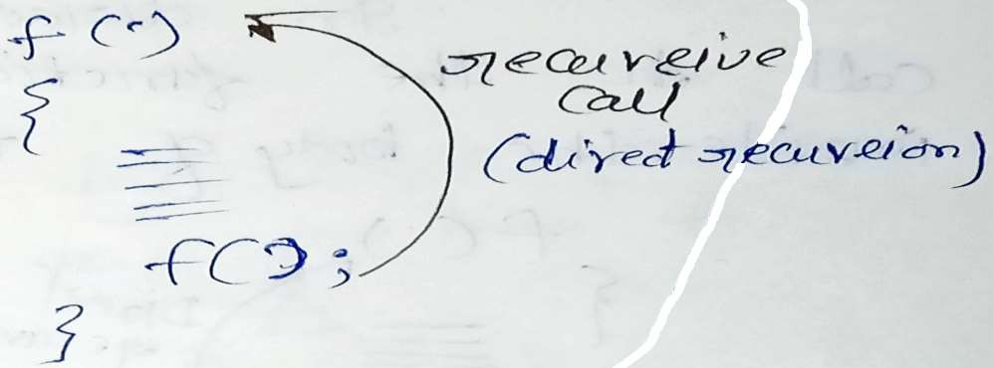
Recursion (Cont…)
The C++ programming language supports recursion, i.e., a function to call itself. But while using recursion, programmers need to be careful to define an exit condition from the function, otherwise it will go into an infinite loop.

Slide 25
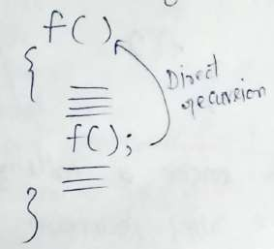
Recursion (Cont…)
There are two types of recursion based on whether functions directly calls itself or it is called via some other functions.
1) Direct Recursion: In direct recursion the recursive call to the function is directly written inside the body of the function.

Slide 26
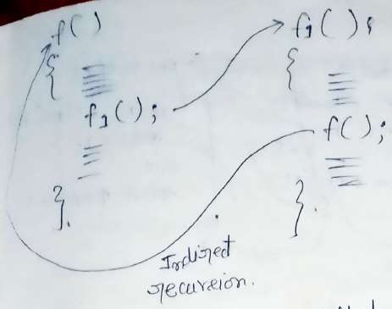
Recursion (Cont…)
2) Indirect Recursion: In indirect recursion the recursive call to the function is not directly written inside the body of the function rather this call lies inside some other function which is invoked (called) from the base function.
Here f1 function is called by base function f and the recursive call to function f lies in body of function f1.

Slide 27
Recursion (Cont…)
Rules of Recursion (Properties): Any recursive function must have following properties
1) It should have a base case. A base case is the case where the recursive function gives the concrete (exact) solution to the input. Therefore it helps in terminating the recursion.
2) The recursive process must proceed towards the base case during the execution.
3) There should be a recursive call.

Slide 28
Recursion (Cont…)
Disadvantages of Recursion:
1. Recursive functions are generally slower than non-recursive function.
2. It may require a lot of memory space to hold intermediate results on the system stacks.
3. Hard to analyze or understand the code.
4. It is not more efficient in terms of space and time complexity.
5. The computer may run out of memory if the recursive calls are not properly checked.

Slide 29


